Slide 1
Preparing to meet web accessibility guidelines:
Step 2…telling
Notes:
Preparing to meet web accessibility guidelines:
Step 2…telling

Slide 2
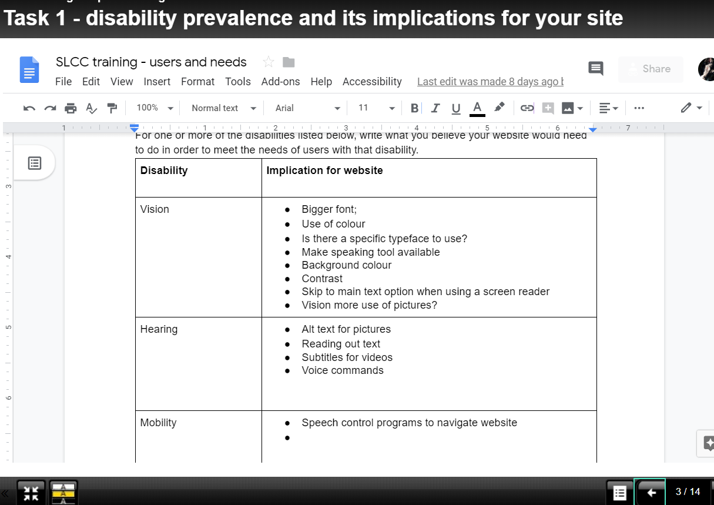
Building on strengths
Remember what you know
Notes:
Building on strengths
Remember what you know - In the last session we looked at disability prevalence and its implications for your site. There was a good level of expertise in people's awareness of how different accessibilities would have different implications for websites. It is important to build on this strength.
https://www.learningapps.co.uk/moodle/xertetoolkits/play.php?template_id=2073

Slide 3
Don’t hide!
Some reassurances
It’s not your fault.
You are not alone:
There are around 11,930 local councils in the UK, including town, parish, community, neighbourhood and village councils.
Others have a role to play - you DON’T need all the answers but you DO need to advocate for your users.
It’s a ramp, not a step BUT you need to plan and describe your ramp.
Notes:
Don’t hide!
Some reassurances
It’s not your fault.
You are not alone:
There are around 11,930 local councils in the UK, including town, parish, community, neighbourhood and village councils.
Others have a role to play - you DON’T need all the answers but you DO need to advocate for your users.
It’s a ramp, not a step BUT you need to plan and describe your ramp.

Slide 4
Making it manageable
There are exemptions,
So use your time wisely
There are ‘disproportionate burden’ clauses
But they need evidence and justification
Notes:
Making it manageable
There are exemptions,
So use your time wisely
There are ‘disproportionate burden’ clauses
But they need evidence and justification

Slide 5
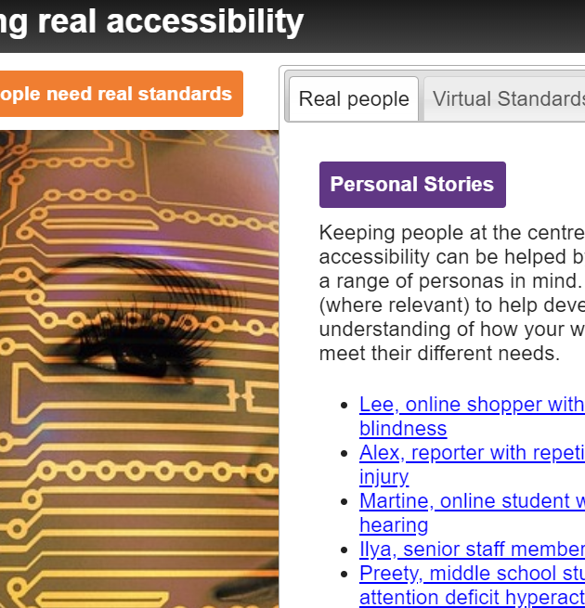
People focus
Moving from what people are like to what people want to do.
What THREE THINGS would the public complain about most if your website was down for a week?
Add them to the chat pane…
Notes:
People focus
Moving from what people are like to what people want to do.
What THREE THINGS would the public complain about most if your website was down for a week?
Add them to the chat pane…
Remember that having a partially accessible website is considerably better for disabled people than having no website at all. one of your challenges is to identify the key journeys people make on your website so you can ensure you prioritise the more important pages that will benefit most people.

Slide 6
Even a semi accessible website
…is better than no website at all
Notes:
Even a semi accessible website …is better than no website at all

Slide 7
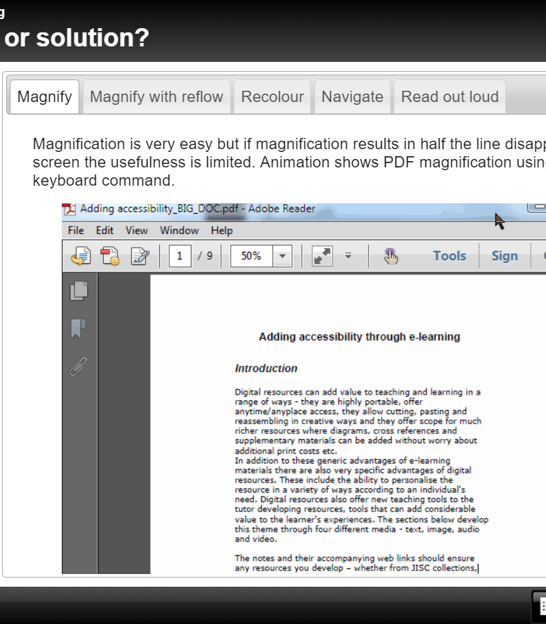
Separating website from downloads
Remember, your downloadable Word documents, PDFs etc will need to be accessible if they are in ‘active admin use’.
Don’t forget to include them in any auditing.
Notes:
Separating website from downloads
Remember, your downloadable Word documents, PDFs etc will need to be accessible if they are in ‘active admin use’.
Don’t forget to include them in any auditing.
Remember also that different people have different roles and responsibilities and we'll need different training. Although the web developer may do a good job at making your website accessible, somebody else is creating documents to be uploaded. Does this person (or these people) know how to make an accessible Word document or PDF document?

Slide 8
The key principles for users
Here’s what you CAN DO that can make your experience better.
Here’s what you CAN’T DO (sorry!) so don’t waste time trying.
Here’s some options if you need the information a different way.
In case we missed anything, here’s how to report a problem.
Here’s where we are in the grand scheme of accessibility
Here’s our plan for improvement.
Here’s how and when we tested the website.
Notes:
Key principles for uses are enshrined in the government's model accessibility template. In simple, plain language, the main sections of the accessibility statement should cover
Here is what you can do to make your experience better
Here's what you cannot (sorry!) do on our website at the moment so don't waste time trying
here are some options if you need the information a different way
in case we missed anything, here's how to report a problem
here's where we are in the grand scheme of accessibility
here's our plann for improvement,
here's how and when we tested the website

Slide 9
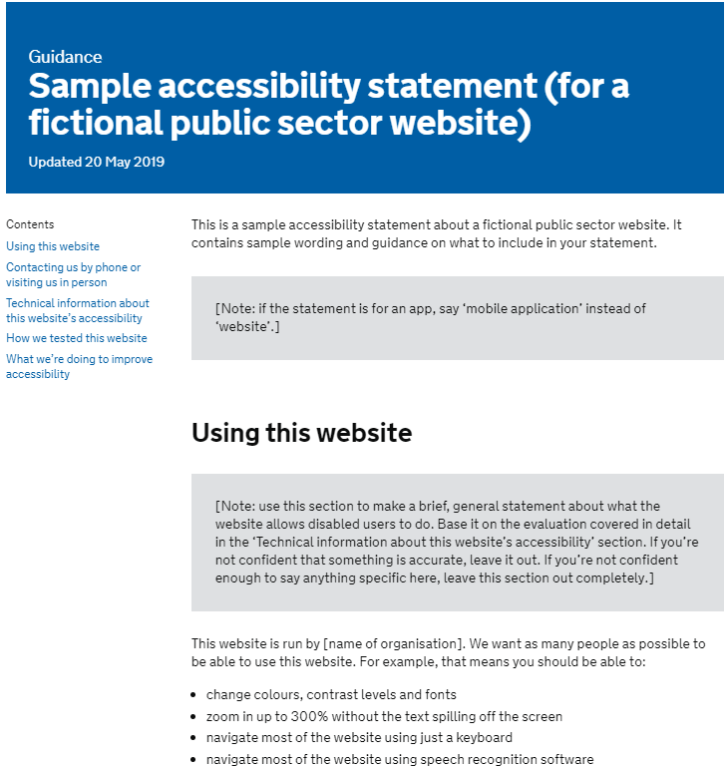
Creating your own first draft of the audit
Notes:
Creating your own first draft of the audit
This part of the presentation takes you to a template based on the government template. It has prompt and spaces for you to fill in, helping you to create your first draft. We will go through this together as a group, giving you a chance to ask questions and discuss your answers as we go.

Slide 10
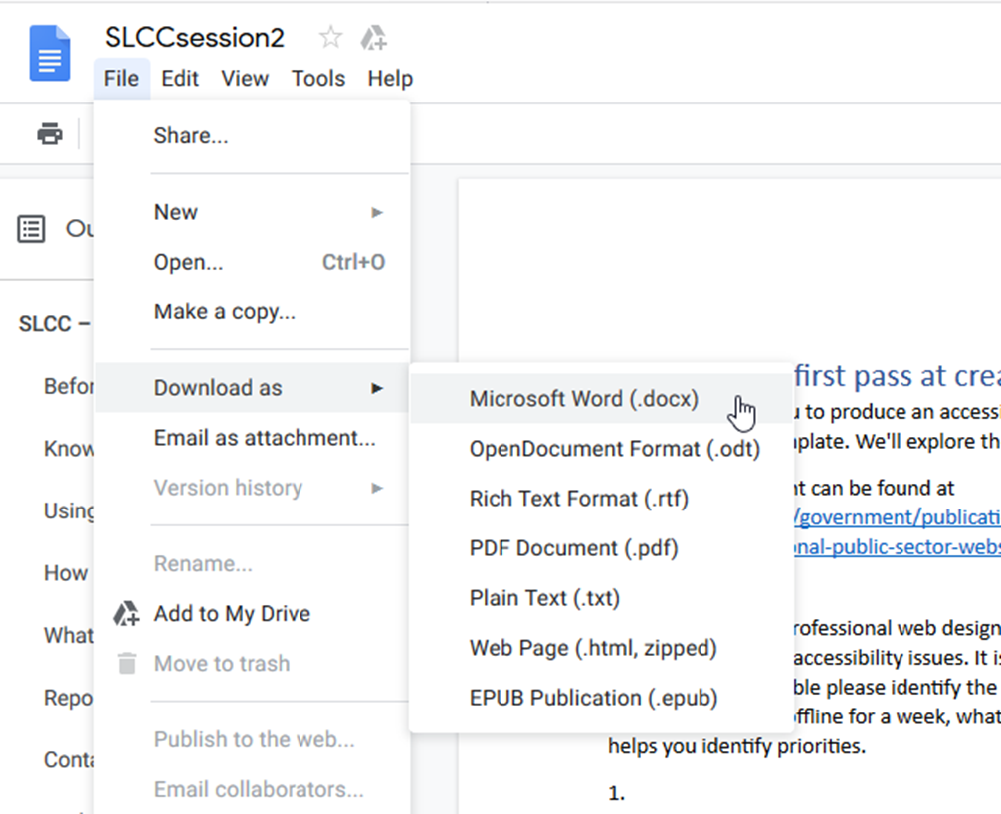
First draft of the audit
http://bit.ly/SLCCpart2
Download it as a Word document (or anything else you can edit)
Notes:
The link you need to the downloadable document is below. It is important not to type into the one on screen because this is shared with everybody. Instead click File, Download as and then choose Microsoft Word. Save it somewhere local and then work on it as we go through the session.
http://bit.ly/SLCCpart2
Download it as a Word document (or anything else you can edit)

Slide 11
Swap to the Word document
Notes:
From this point on the session switches to using a screen share of the word document.

Slide 12
And finally…
Messages for managers
Who else needs to support you in this?
What kind of support do you need?
What are the processes (website auditing, alternative format requests, complaints processes) that your council needs to consider?
What back-up will you get negotiating with web developers?
Notes:
And finally… messages for managers…
Who else needs to support you in this?
What kind of support do you need?
What are the processes (website auditing, alternative format requests, complaints processes) that your council needs to consider?
What back-up will you get negotiating with web developers?

Slide 13
Good luck!
It’s not compliance. It’s customer service
Notes:
Good luck!
It’s not compliance. It’s customer service

